Slide 1









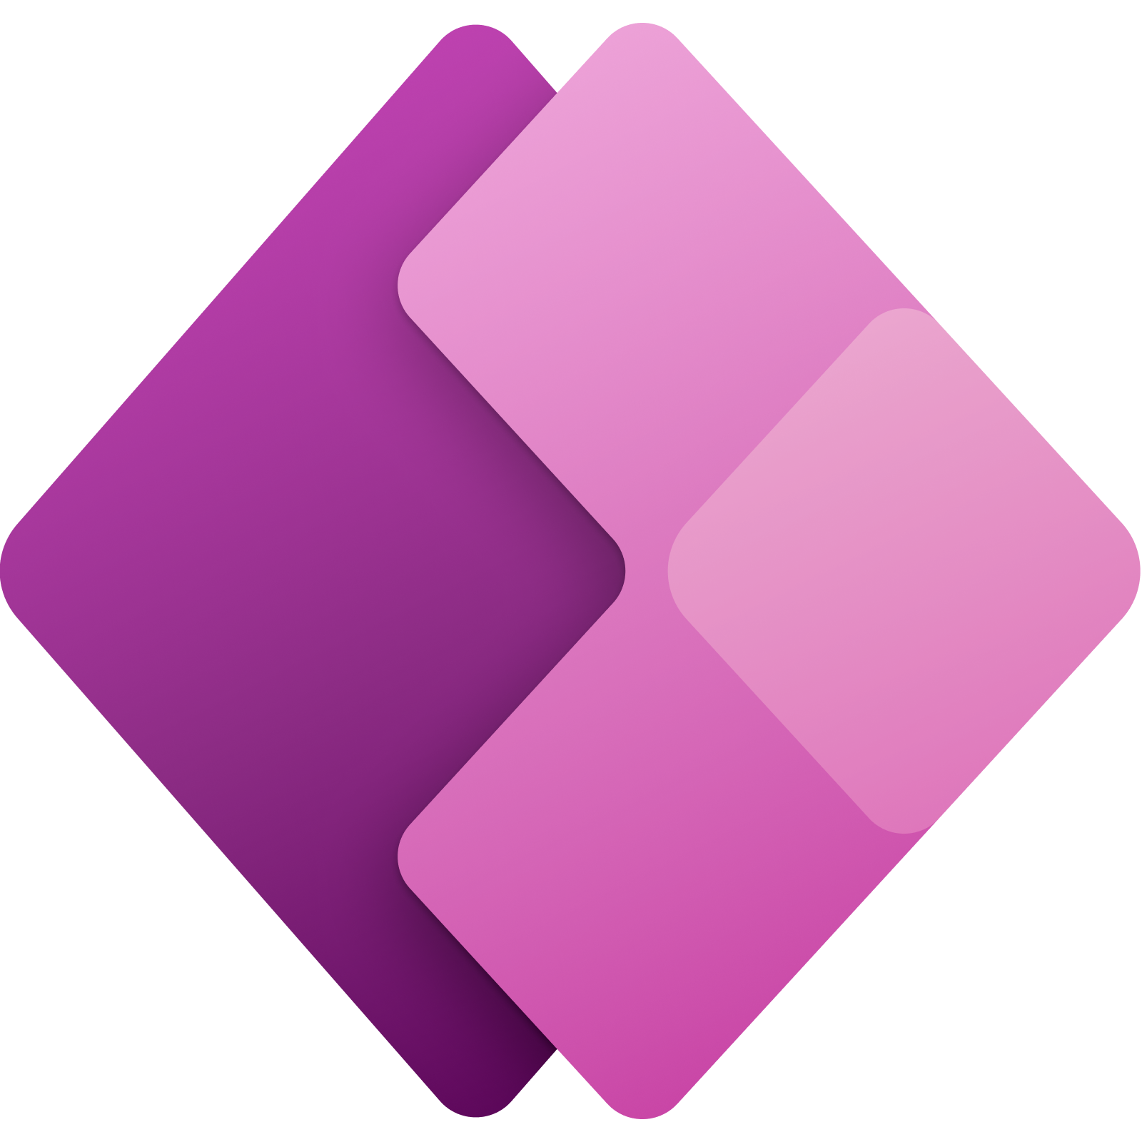


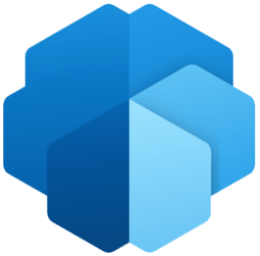










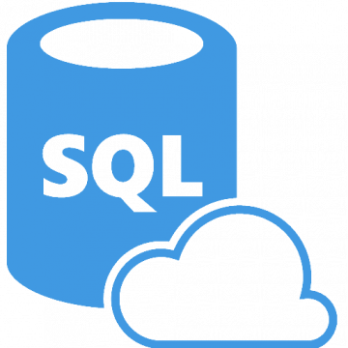

Microsoft Data & AI (for both technical and non-technical users)
Vertical SaaS (specific to industry domains)
Generative AI
Customer Insights
(segmentation, campaigns)
Healthcare Data & AI
(DICOM, FHIR, InnerEye)
Nuance Suite
(Engagement, etc.)
Azure Data Manager for Agriculture
Azure + Open Education Analytics
Microsoft Designer
(Visual Arts and content)
Bing + GPT
(Internet Search & Chat)
Marketing | Healthcare | Agriculture | Education | Design / Arts | Internet
Automation
+ other advanced tools
Power Platform (SaaS, business users and citizen devs with low/no-code)
Generative AI
Power Automate | Power Apps | Power Virtual Agents | Power BI | AI Builder
Reinforcement Learning
/ optimization
Azure AI (PaaS, technical implementations)
Operational Research
Applied AI services (niche applications, for devs and AI engineers)
Recommender Systems
microsoft/recommenders
Bot Service | Cognitive Search (Files) | Form Recognizer (OCR) | Video Indexer | Metrics Advisor | Immersive Reader
AI Governance Toolkit
(free, open source)
Deep Learning /NLP
Cognitive Services (high quality AI models + easy UI-enabled training + API model consumption)
GPT 3.5turbo & 4
DALL·E 2
Generative AI
Vision (AI for images & video) | Speech (Voice, STT, TTS) | Language (NLP & NLG) | Decision (basic recommenders) | Azure OpenAI Service
Others (open source)
Semantic Kernel – Orchestration for LLM AI
Bot Framework – SDK for Bot development
Fed. Data Spaces - Eclipse Data Connector
FLUTE – Federated ML Framework
ONNX – Neural Network Framework
SynapseML – Distributed ML on Spack
LightGBM – Gradient Boosting Framework
NNI – AutoML Toolkit
DeepSpeed – DL optimization for inference
Pytorch Foundation – MSFT as board member
Machine Learning
ML Platforms (for data scientists and engineers)
Storage/DBs
Data Analytics.
Data Governance.
(multi-cloud and on-prem)
AutoML
Datalake Gen2
Copilot
Azure SQL (PaaS, IaaS)
Azure ML Azure Databricks MLOps AI-enabled Coding
CosmosDB (NoSQL)
Synapse
(SQL-DWH)
Data Explorer
(IoT, log, telemetry)
Microsoft Purview
HUGGING FACE
(native endpoints)
Generative AI
DOLLY (Open-source LLM)

